Slide 1
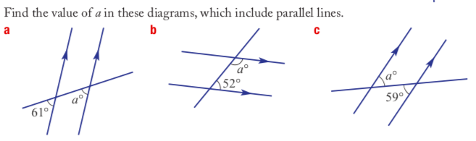

Starter Questions
Sort these numbers into ascending order (smallest to biggest): 12, 15, -13, -17, 11, -15
2. What is the size of an angle that is COMPLEMENTARY to 35 degrees?
3.
4.

Slide 2

Learning Intentions
To add and subtract negative integers
WICOR

Slide 3

24
7
30
Number systems
Date
EQ – How do we add or subtract negative integers?
We already know how to add and subtract positive integers (just normal + or -)
Normally all our numbers are positive, so we never had to write (+) in front of them
We also know that negative numbers are the opposite of positive numbers (from yesterday)
Numbers get larger (more positive = less negative) on the Right Hand Side of a number line
Numbers get smaller (more negative = less positive) on the Left Hand Side of a number line
Which direction is (+) or (–) on a Number Line?
Negative
Positive
Summary:

Slide 4
24
7
30
Number systems
Date
EQ – What are directed numbers and how do they relate to integers?
Using a number line (in class or out on the balcony) practice like this:
The first number in a sum is your starting point,
eg 3, so stand at 3 (or imagine you are)
The operator (add + or subtract -) tells you which way to face,
eg if it’s a plus turn to face the right, if it’s a minus turn to face left
The second number tell you how many steps to move – forward if it’s a positive number, backwards if it’s a negative number (remember, they’re opposites!)
eg if it’s (-3) take 3 steps backwards.
Where you finish is the answer!
3+(-3) = ?
3- (-3) = ?

Slide 5
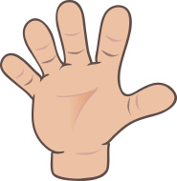
Do you understand? Fists of Five
Notes:
Check for Understanding

Slide 6


Practice Questions
Use a number line to help you find these answers:
Adding negative numbers
Subtracting negative numbers

Slide 7
Summary
Using the number line, facing to the right (adding) and taking steps backward (negative numbers) is the same as facing to the left (subtracting) and taking steps forward (positive numbers)
Therefore adding a negative number is the same as subtracting a positive number.
And subtracting a negative number is the same as _____________?

